Slide 1
Chatbots Development with Amazon Lex
Overview of AWS
Salient Features of AWS
Chatbot Development with AWS Lex
Shahzaib Hamid
AI Sciences Instructor

Slide 2

Module Overview
Amazon Web Services (AWS)
Amazon Lex Bot
Overview
Services
Salient Features
Overview
Benefits
Conceptual Framework

Slide 3

Overview of Amazon Web Services (AWS)
World’s Most Comprehensive and Widely Adopted Service
Most Functionality
Largest Community of Customers
Most Secure
Fastest Pace of Innovation
Proven Operational Expertise
Power Customer Innovation
AWS

Slide 4
Services Provided by AWS
AWS is Offering More than 200 Services in Domain i.e.,
Compute
Database
Migration
Network and Content Delivery
Management Tools
Messaging
Storage
Security & Identity Compliance

Slide 5
Salient Features of AWS
Main Features of AWS
Pricing
Flexibility & Scalability
Global Architecture
PaaS Offerings
Scheduling
Customization
Recovery
Security
API
Consistency & Reliability

Slide 6

Amazon Lex Bot
Overview

Slide 7
Benefits of Amazon Lex Bot
Main Benefits of Amazon Lex Bot
Simplicity
Seamless Deployment and Scaling
Built-in Integration with AWS
Input Technologies
Cost-Effective

Slide 8
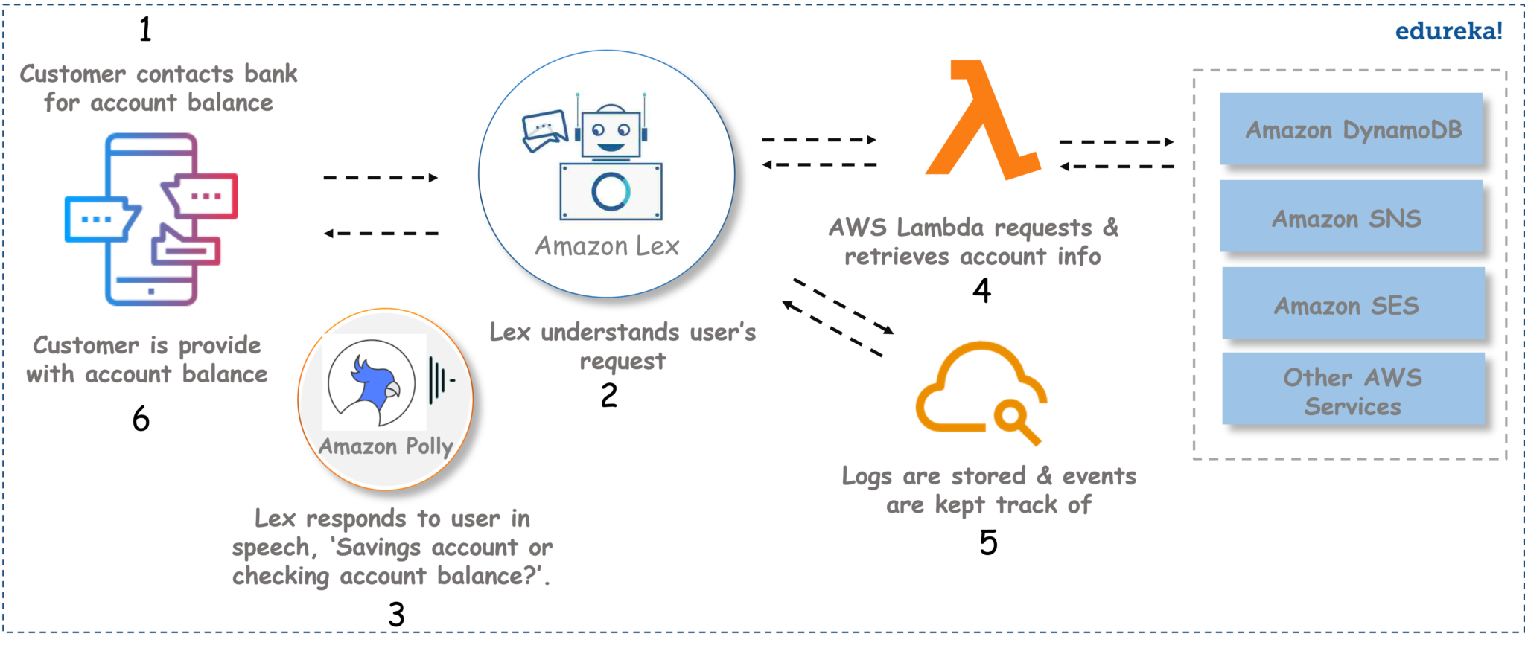

Conceptual Framework of Amazon Lex Bot

